Slide 1
The Research Question
So you observe something of interest and you ask yourself Why?

Slide 2
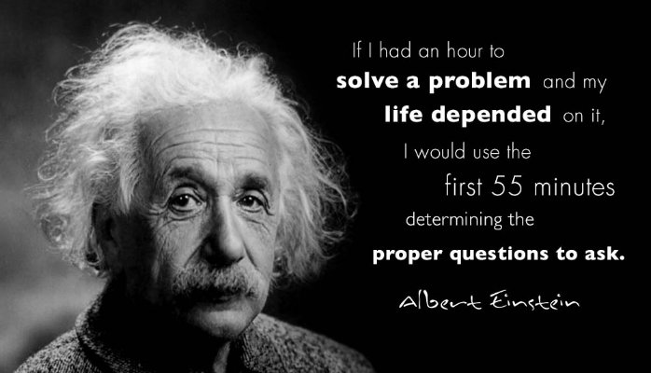
The Research Question

Slide 3
The Research Question
Not only do you have to ask the right question, but the question needs to be worded in such a way that it can answered through research.

Slide 4
The Research Question
For example: “Do children learn better using computers?” does not make a good research question.
Is agile methodology a better software development method?

Slide 5
The Research Question
Also the way the question is worded will depend on the research method you wish to employ. But generally the question comes first then the research method.

Slide 6
The Research Question
For example: “Do children learn better using computers?” does not make a good research question.
Is the agile method a better software development method?

Slide 7
The Research Question
In quantitative research the questions relate attributes or characteristics of individuals or organisations.
In qualitative research the questions include a central concept being explored.

Slide 8
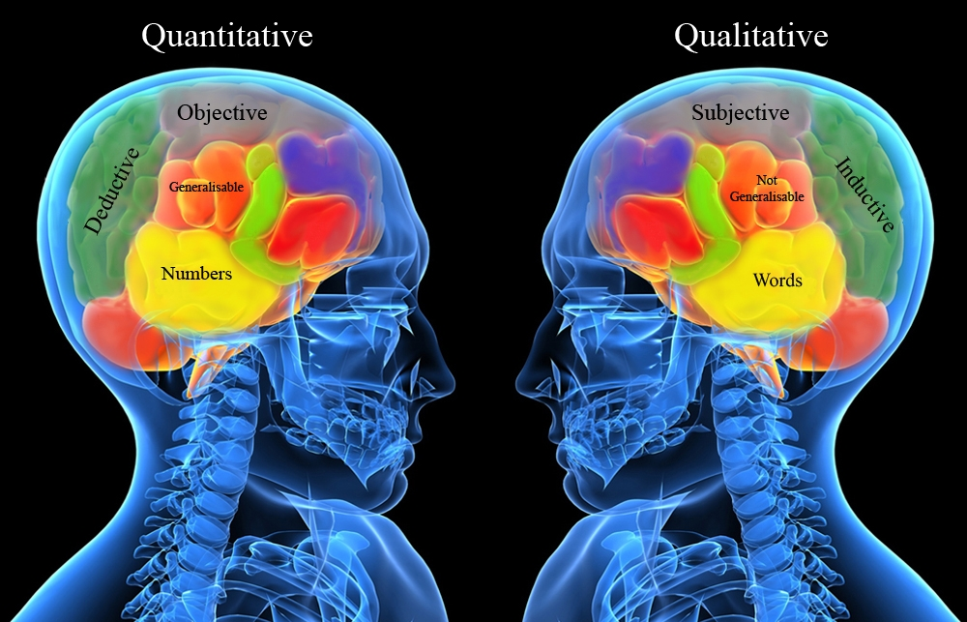
Qualitative Purpose Statements
In this part we will be looking at Qualitative Research

Slide 9
The Research Question
Research Question: an example
Quantitative Research
“Do parent-teacher Internet communications affect student performance in the classroom?”
Qualitative Research
“What types of Internet experiences of parents have with teachers about the performance of the parents children?”

Slide 10
The Research Question
Variables
To carryout any quantitative research you need to have identified the main variables.
A variable is a characteristic or attribute of an individual or an organisation that (a) researchers can measure or observe and (b) varies among individuals and organisations being studied.

Slide 11
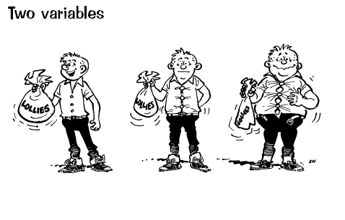
The Research Question
Variables
Subjects scores will vary, hence the term variable.

Slide 12
The Research Question
Theories and hypothesis
In quantitative research we seek to test whether the independent variable influences the outcome or dependent variable.
A theory in quantitative research explains and predicts the probable relationship between dependent and independent variables.

Slide 13
The Research Question
Theories and hypothesis
This relationship is tested over and over, with different scenario's, repeatedly similar results are shown. Then someone calls this relationship a theory, this is reported in the literature and then researchers test that theory.
Theories are just broad explanations as to what we would expect to find when we relate variables

Slide 14
The Research Question
Theories and hypothesis
Also there is the Null hypothesis.
Null Hypothesis makes predictions that of all the possible people whom researchers might study there is no relationship between the independent and dependent variables

Slide 15
The Research Question
Theories and hypothesis:
Null hypothesis No relationship
Alternative Hypothesis There is a relationship, if the relationship is true then you reject the null hypothesis.

Slide 16
Qualitative Purpose Statements
Quantitative
Uses Hypothesis
Multiple Variables
Test Theories
Closed ended stance
Deductive
Measure differences
Qualitative
Hypothesis not used
Single concept
General themes
Open ended stance
Inductive
Understanding of views

Slide 17

Qualitative Purpose Statements
Qualitative Research
Central component of the research question in qualitative research is the central Phenomenon

Slide 18

Qualitative question
Qualitative Research
The point with qualitative research questions are that they don’t seek to quantify. They are more concerned with how organizations and individuals operate. The response are generally not numeric, but can consist of opinions and thoughts about the central phenomenon

Slide 19
Qualitative Purpose Statements
The central phenomenon is a concept or process explored in qualitative research.
i.e. Who identify as ethnic Maori in New Zealand?

Slide 20
What you need to ask for!
What permissions do you need.
After selecting participants for the study, the researcher needs to obtain permission from the participants to be the subjects of the study. This permission will ensure that they cooperate in the study.

Slide 21

What you need to ask for!
What permissions will you need.
Also an important part of the permissions is the idea of informed consent. That the subject fully understands the purpose and intent of the study and what will happen to them and their data.

Slide 22
What you need to ask for!
Who to obtain permissions from:
1. Institutions or organizations.
2. Specific sites.
3. Participants.
4. If participants are minor then their parent/caregiver.
5. If participant is unable to give informed consent then their caregiver.
6. A research board or ethics committee.

Slide 23

What you need to ask for!
What permissions will you need.
Failure to gain informed consent, could lead to the study being invalidated on ethical grounds. Subjects must be given the all the information, not half or different.

Slide 24

What you need to ask for!(EXAM Q)
So to gain informed consent from your subject you cannot:
1. Allow them to come to any physical harm.
2. Allow them to come to any Psychological harm.
3. Lie to them about the nature or purpose of the study.

Slide 25

Research Design
Grounded Theory – Is a systematic, qualitative procedure used to generate a theory that explains, at a broad conceptual level, a process, an action, or an interaction about a substantive topic.

Slide 26
Research Design
Grounded theorists proceed through a systematic set of procedures; collecting data, identifying categories, connecting these categories and forming a theory that explains the process.

Slide 27

Research Design
You use grounded theory when you need a broad theory or explanation of a process. Grounded theory generates a theory when an existing theories do not address the problem.

Slide 28
Research Design
Types of Grounded Theory Designs –
Systematic Design emphasizing the use of data analysis step of open, axial, and selective coding and the development of a logic paradigm or visual picture of the theory generated.

Slide 29
Research Design
Grounded Theory –
Emerging Design – Glasser (1992) stressed that letting a theory emerge from the data rather than using specific, preset categories. The objective of grounded theory study was for the author to explain the basic social process. This explanation involved constant comparative coding procedures to comparing incident to incident, incident to category, and category.

Slide 30

Research Design
Grounded Theory – Constructivist Design –
Is more a philosophical position, and lies between the positivism (Qualitative) researchers and the post-modernist researchers who challenge the importance of methods.

Slide 31

Research Design
Grounded Theory – Constructivist Design –
The focus is on the meanings ascribed by participants in the study. More interested in the views, values, beliefs, feelings, assumptions, and ideologies of the individuals than facts and describing acts.

Slide 32

Research Design
Grounded Theory – Constructivist Design
Argue that any aspect that obscures experiences, such as complex terms or jargon, diagrams, or conceptual maps, detract from grounded theory and represent an attempt to gain power in their use.

Slide 33

Research Design
Grounded Theory – Constructivist Design – Emphasise the role of the researcher they make decisions about the categories through out the study. They bring certain questions to the data along with a store of sociological concepts, and their own world view.

Slide 34
Research Design
A grounded theorist explains the feelings of individuals as they experience the process.
“What it means to have the disease.” (Charmaz, 1994)

Slide 35
Research Design EXAM!!!!!!!!!!!
Constuctivist
In both cases, the theory of constructivism suggests that learners construct knowledge out of their experiences. However, constructivism is often associated with pedagogic approaches that promote active learning, or learning by doing.

Slide 36
Research Design EXAM!!!!!!!!
The term postmodernism has been applied to a host of movements, mainly in art, music, and literature, that reacted against tendencies in modernism, and are typically marked by revival of historical elements and techniques.
Postmodernism is renowned for its extravagant aestheticism, irregular beauty and unashamed devotion to style over substance.

Slide 37
Research Design EXAM!!! may
Grounded Theory – Key Characteristics
1. Process approach
2. Theoretical sampling
3. Constant comparative data analysis
4. A core category
5. Theory generation
6. Memos

Slide 38
Research Design
Grounded Theory – Ethical issues
The writing on grounded theory are largely silent on ethical issues in the conduct of research. This does not mean that grounded theory is unethical.

Slide 39
Research Design
Grounded Theory – Ethical issues
Ethical issues face grounded theory researchers when they declare the purpose of the study knowing that it will emerge through the grounding in the participants views. It does raise the question of power and authority and giving appropriate voice to participants about the research process

Slide 40

Research Design
Ethnographic Research is a qualitative methodology. It is used for describing analysing and interpreting a culture-sharing groups patterns of behaviour, beliefs, and language that develop over time.

Slide 41
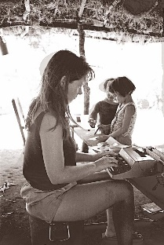
Research Design
You conduct an ethnography when the study of a particular group provides understanding of a larger issue

Slide 42
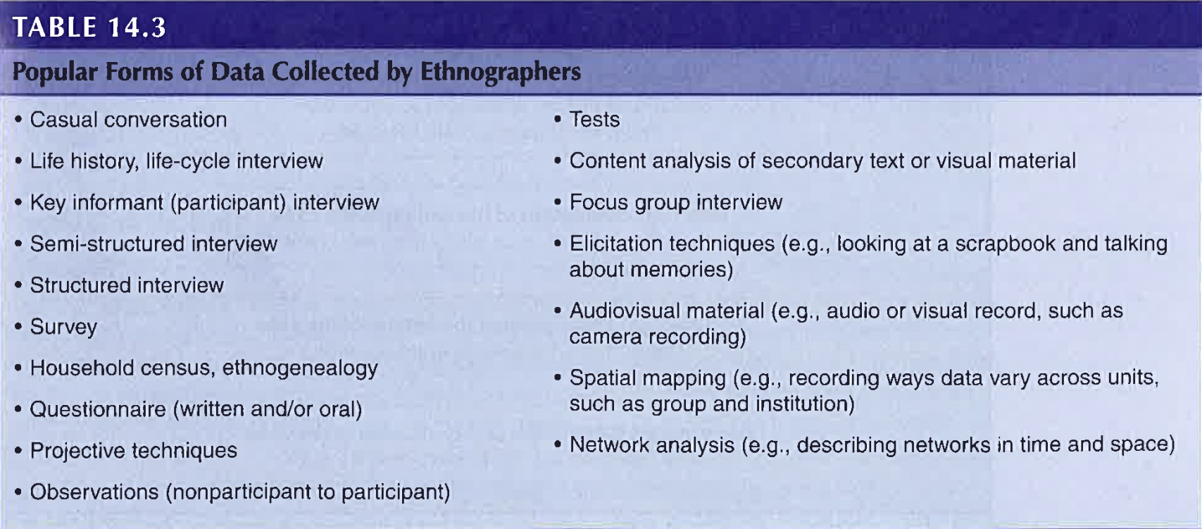
Research Design

Slide 43
Research Design
Correlational Designs – A correlation is a statistical test to determine the tendency or pattern for two or more variables or two sets of data to vary consistently.

Slide 44
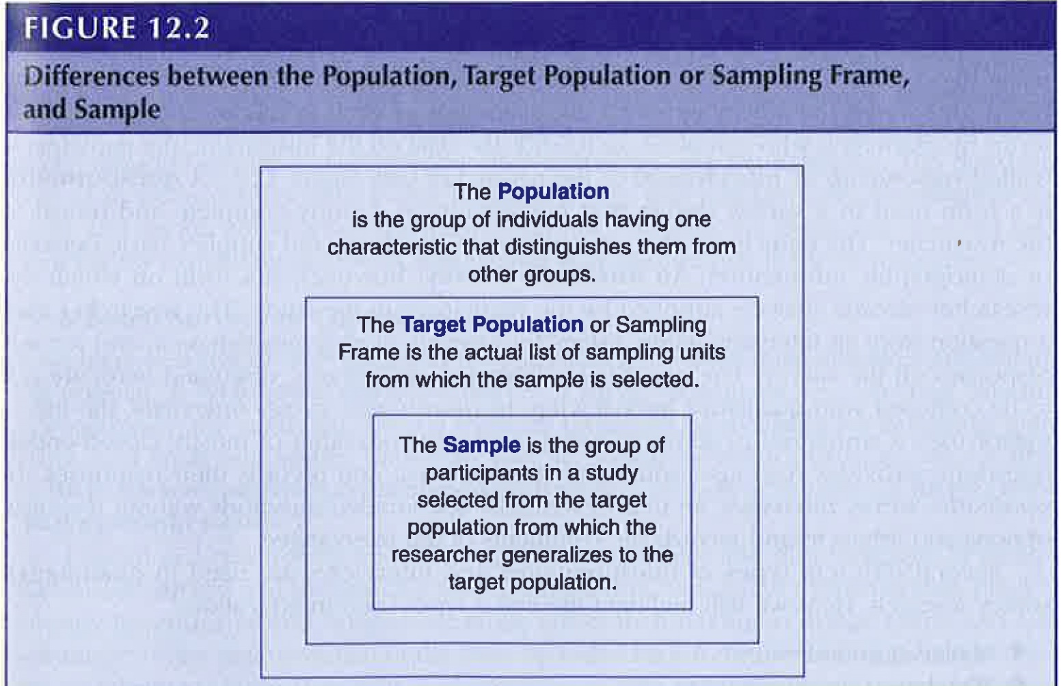
Research Design
Survey Designs – Characteristics of Survey Research
Sampling from a population - researchers study a sample of the population and generalize back to that population.

Slide 45
Research Design
Survey Designs – Characteristics of Survey Research
Questionnaires and Interviews, Questionnaire is a form used in survey where the participants complete and mail the form back to the researcher.
Interview the research asks the questions and records the answer on the interview form.
The difference between quantitative and qualitative is in the types of questions.

Slide 46
Collecting the Data
Five steps in the process of data collection.
The first step in the process of collecting data is to identify the people, places and the things you plan to study.

Slide 47
Collecting the Data
In the early stages of data collection you must decide on what level the data needs to be gathered. This level is called a unit of analysis. For example; individual, school or work place. In some cases researcher will gather data from multiple levels.

Slide 48

Collecting the Data
Population
A population are a group of individuals that share common characteristics, for example the students of Whitireia is the population, and the IT class is the sample of that population.

Slide 49
Collecting the Data
Specify the population and sample
The need to select individuals or organisations that are representative of the population. This is called a sample.

Slide 50
Collecting the Data
Probabilistic and Nonprobabilistic Sampling
Researchers employ either probability or non probability sampling methods. They decide which to use based on the type of study.

Slide 51

Collecting the Data
Probability Sampling
The researcher selects individuals from a population who are representative of that population. This is the most rigorous form of sampling because the researcher can claim that the sample is representative of the population.
This allows the researcher to make a generalization to the population

Slide 52
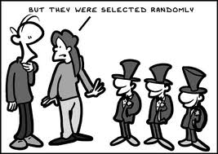
Collecting the Data
Types of Probability Sampling
Simple Random Sampling.
The researcher selects participants for the sample so that each individual has an equal probability of being selected from the population.

Slide 53

Collecting the Data
Random Sampling
Any bias in the population will be equally distributed among the sample chosen.

Slide 54
Collecting the Data
Random Sampling
Typical procedure used in random sampling is to assign a number to each individual in the population and then use a random number table or generator to select subjects.

Slide 55
Collecting the Data
Systematic Sampling(504435)
A slight variation on random sampling.
In this procedure you choose every nth individual in the population until you reach your desired sample size.

Slide 56
Collecting the Data
Systematic Sampling
This procedure is not as precise or as rigorous.
May be more convenient to use as you don’t have to assign numbers to every individual.

Slide 57
Collecting the Data
Stratified Sampling
The researcher divides(stratify) the population on some specific characteristic, i.e. gender.

Slide 58
Collecting the Data
Stratified Sampling
When do you use stratification – You use stratification when the population reflects an imbalance of a characteristic in a sample.

Slide 59
Collecting the Data
Stratified Sampling
Also is used when a random sample would provide too fewer participants in a specific category.

Slide 60
Collecting the Data
Multistage Cluster Sampling
The researcher chooses a sample in two or more stages because either researcher cannot easily identify the population or the population is too large.

Slide 61
Collecting the Data
Multistage Cluster Sampling
A researcher may randomly select groups and then select subjects from within those groups.

Slide 62

Collecting the Data
Nonprobability Sampling
It is not always possible to randomly sample.
In nonprobability sampling the researcher selects subjects because they are available.

Slide 63

Collecting the Data
Nonprobability Sampling
The research selects individuals because they are available, convenient, and represent some characteristic the investigator wants to study. Researchers use two methods of nonprobability sampling, convenience and snowball.

Slide 64
Collecting the Data
Convenience sampling
Researcher selects participants because they are willing and available to be studied.
The researcher cannot with any confidence say that the individuals are representative of the population.

Slide 65
Collecting the Data
Sample Size
A general rule of thumb is to select as large a sample as possible. The larger the sample the less potential there is for sample being different from the population.
This difference between the sample and the population is called a sampling error.

Slide 66
Experimental Design
Don’t confuse random assignment with random selection.

Slide 67
Threats to Validity
Statistical conclusion validity
refers to the appropriate use of statistics ( violating statistical assumptions)
Construct Validity
means the validity of inferences about constructs.
Internal Validity
which relates to the validity of inferences drawn about the cause and effect relationship between the InV and the DV.
External Validity
refers to the validity of the cause-and - effect relationship being generalizable to the population.

Slide 68
Threats to Internal Validity
History
Maturation
Regression
Selection
Mortality
Interaction with selection

Slide 69
Threats to Internal Validity (relates to procedures)
Testing (sometimes testing-retesting)
Instrumentation

Slide 70
Threats to External Validity
Interaction of selection and treatment
Interaction of setting and treatment
Interaction of history and treatment

Slide 71
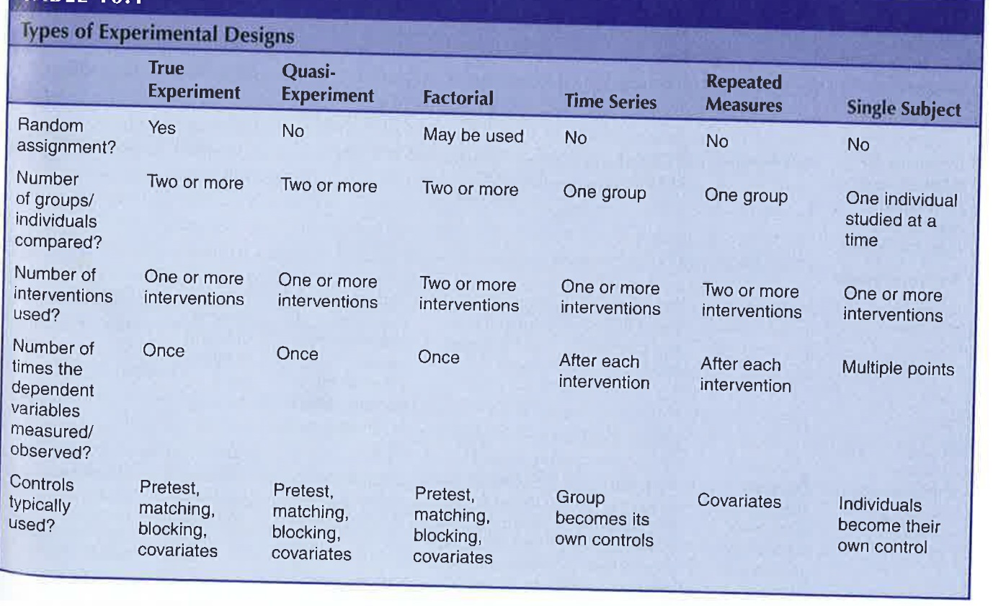
Threats to internal validity in types of experimental design.
(Two Causes of internal validity)

Slide 72
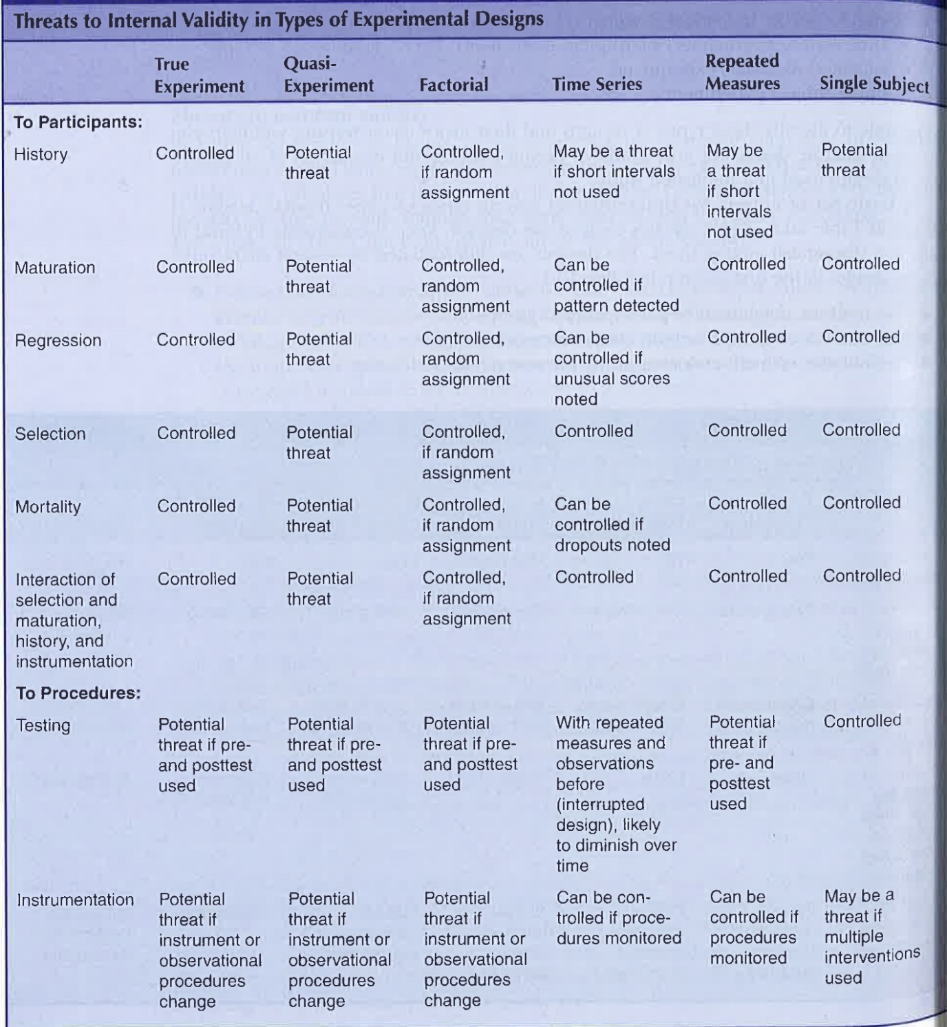
Threats to internal validity in types of experimental design.
(Two Causes of internal validity)

